Slide 1
Automatic Classification of purpose of software usages in scholarly articles
By: Bekalue Tadesse
20th April 2022

Slide 2
Overview
Software in a research
Software Usage purposes
Literature
Ontologies
SoMeSci Dataset
Classifier Models
Classifier Model training results
Conclusion

Slide 3
Software in a research
software is pervasive in modern research
Scientists create or use software
Surveys in the UK and US

Slide 4
Role of Software in a research
Software:
Dictates research quality [24, 63]
Helps to explore/understand research problem [24]
Helps to document research process and results [29]

Slide 5
Problems
Poor Citation
Reproducibility
Reliability of Research results
Some scientists retracted their paper due to software error

Slide 6
Solution: extract info about software
Discover similar software tools
Compare results from different software
=> discover hidden errors in a software
=> ensure research result reliability
Semantic browsing of related research articles

Slide 7
Types of software info
information about software
Explicit info.
Implicit info. (Hidden in text )
URL
Version
Name of Developer
Type of mention
Type of software
Purpose of software

Slide 8
Info extraction approaches
Manual
Rule based (e.g. Regular expressions)
Automatic (e.g. Machine/Deep Learning)

Slide 9
Automatic Extraction of software Usage purposes
Identification of software usage purposes
Annotate SoMeSci Dataset with software purpose.
Model selection
Classification and
Evaluation

Slide 10
Identification of software usage purposes
Literature
Software Ontologies
Wikidata
The software Ontology (SWO)
OntoSoft
Sci-Crunch

Slide 11
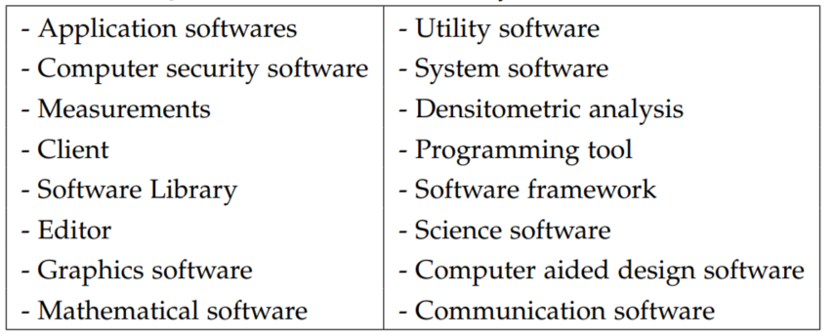
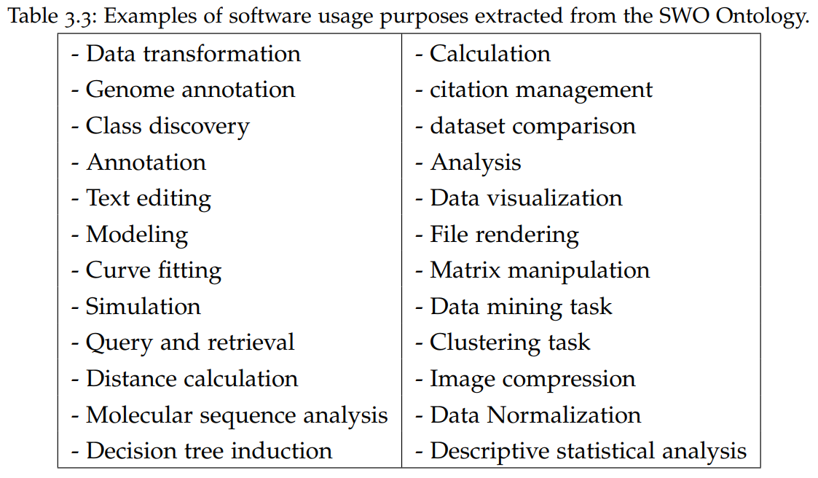
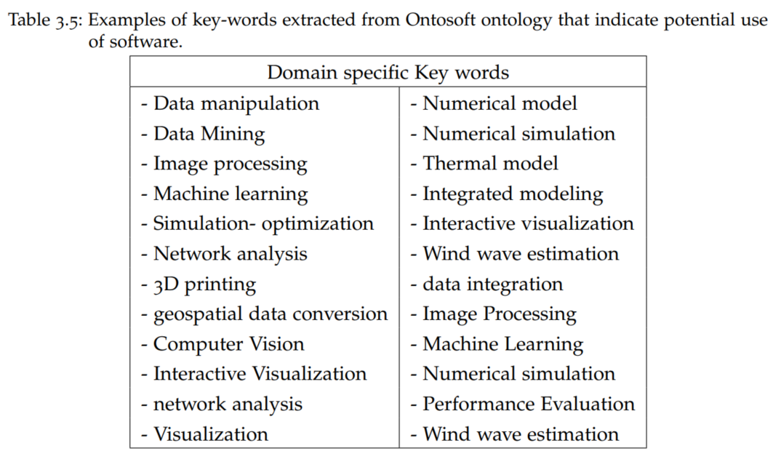
Identification of software usage purposes
WikiData
SWO
OntoSoft

Slide 12
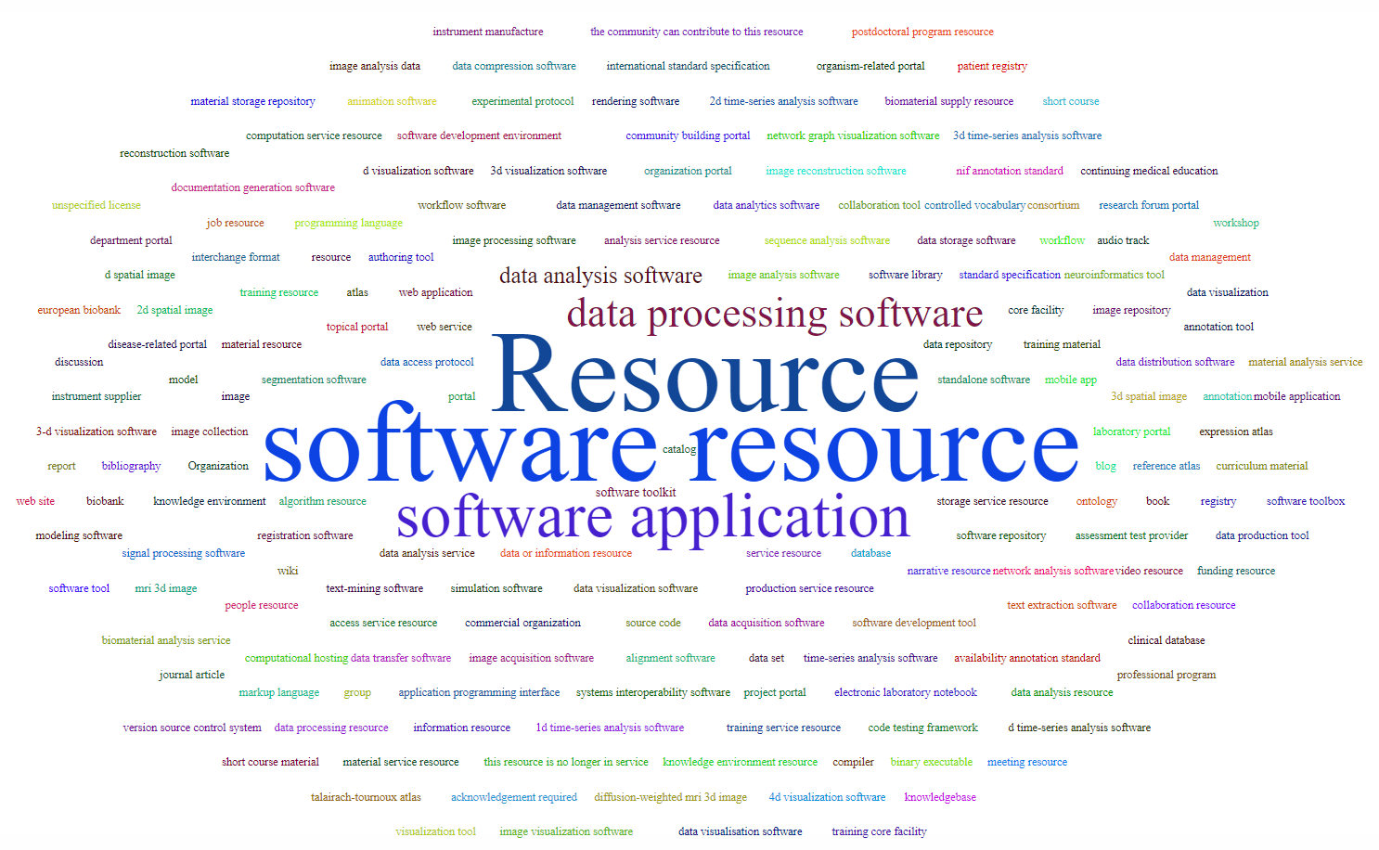
Identification of software usage purposes

Slide 13
Identification of software usage purposes
Data Collection
Data Pre-Processing
Data Analysis
Data Visualization
Simulation
Stimulation
Modeling
Programming

Slide 14
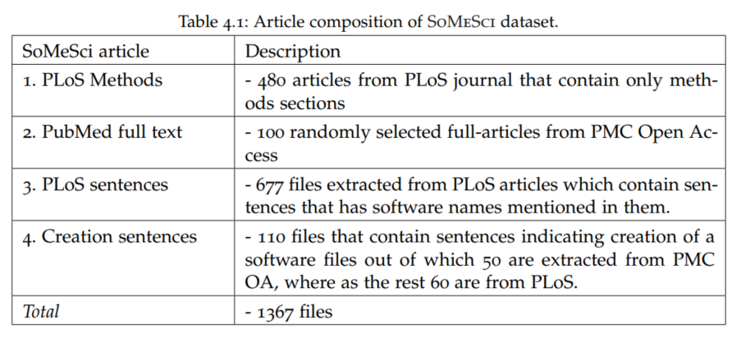
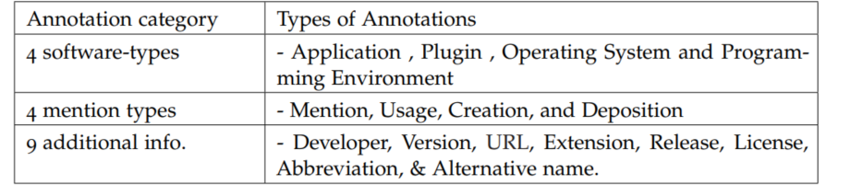
2. Annotate SoMeSci Dataset with software purpose.
2.1. The Dataset

Slide 15
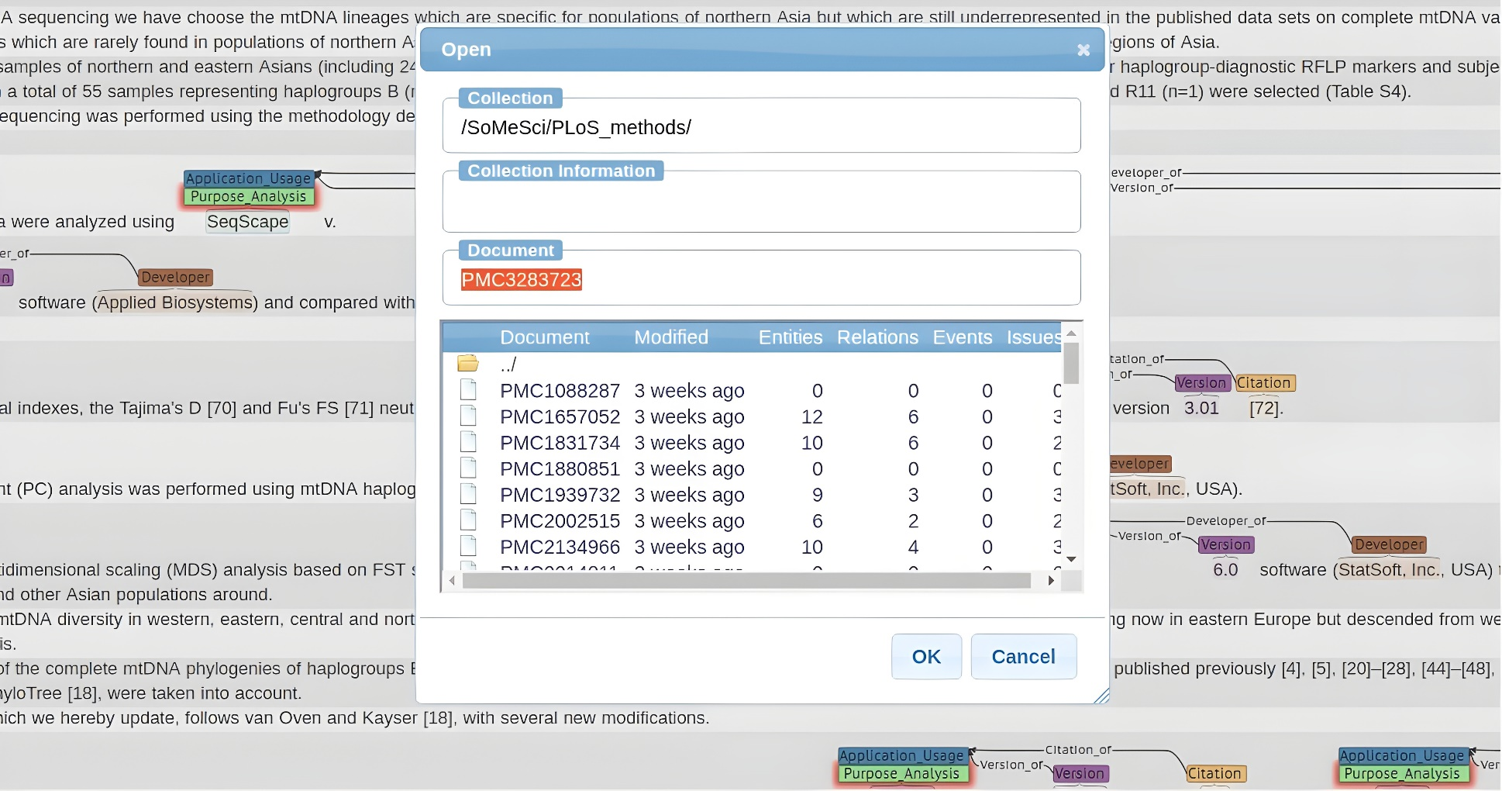
2. Annotate SoMeSci Dataset with software purpose.
2.2. Annotation Tool: BRAT

Slide 16
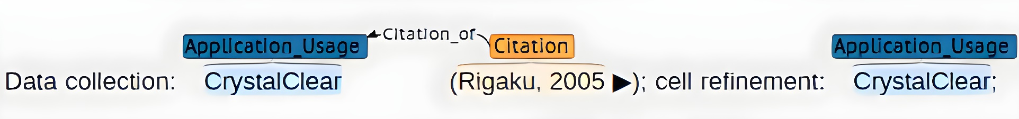
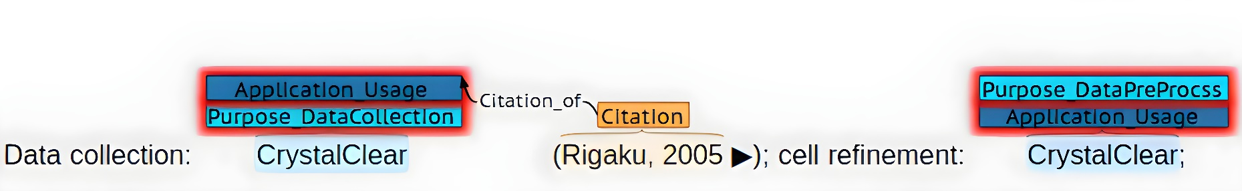
2. Annotate SoMeSci Dataset with software purpose.
2.3. Annotation with software Purpose

Slide 17
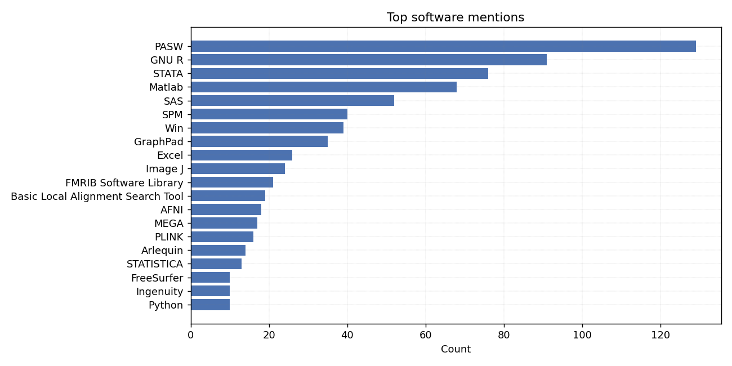
2. Annotate SoMeSci Dataset with software purpose.
2.4. Analysis of Annotated data

Slide 18
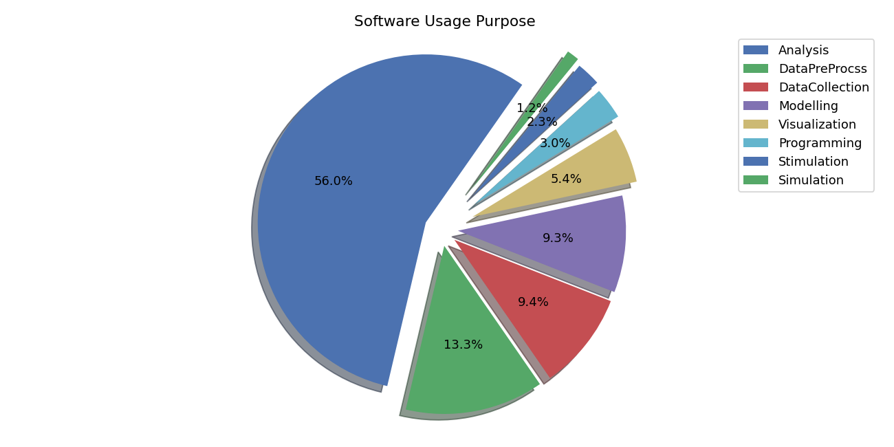
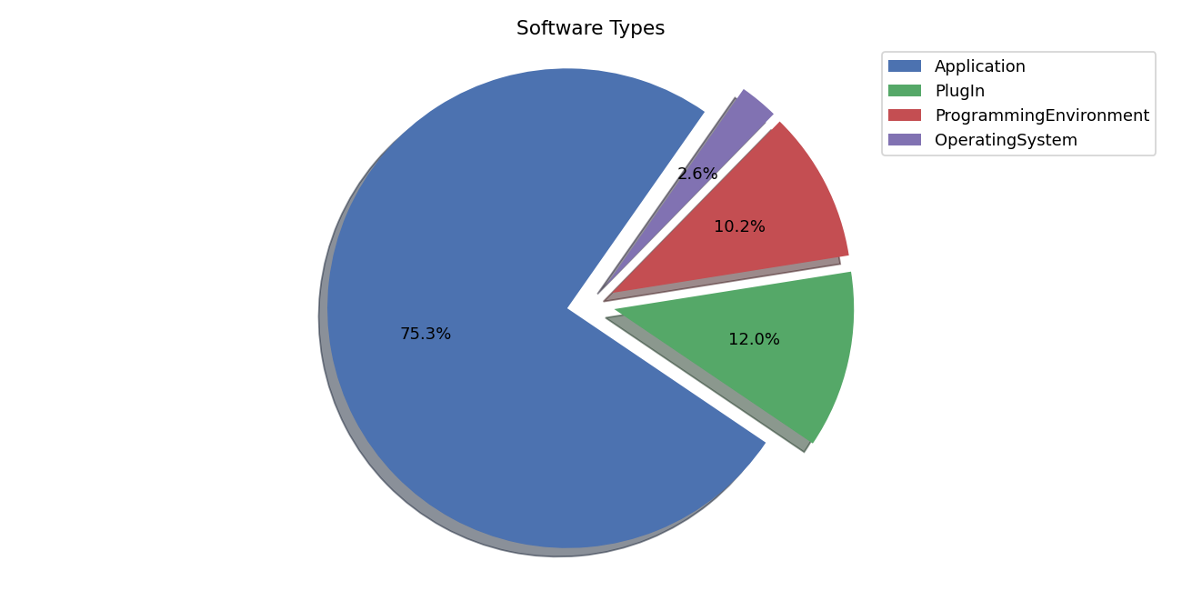
2. Annotate SoMeSci Dataset with software purpose.
2.4. Analysis of Annotated data

Slide 19
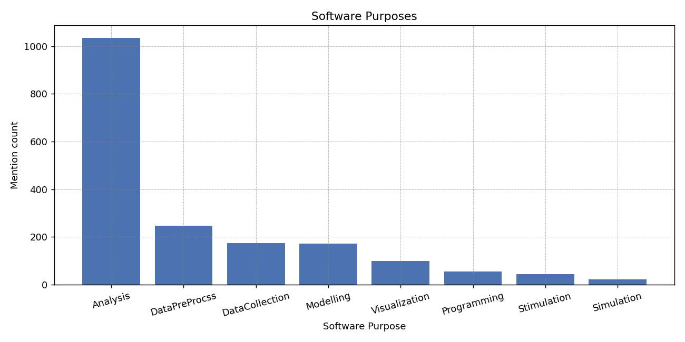
2. Annotate SoMeSci Dataset with software purpose.
2.4. Analysis of Annotated data

Slide 20
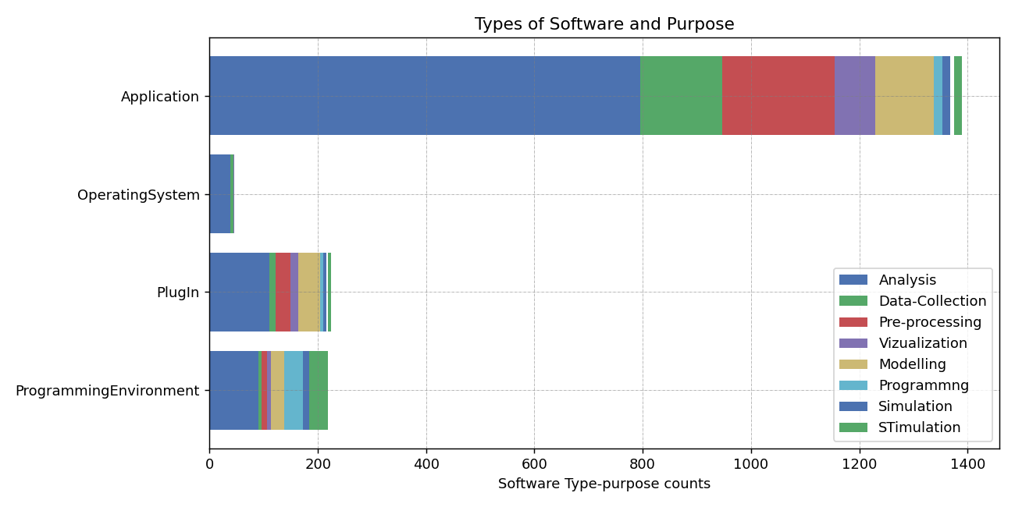
2. Annotate SoMeSci Dataset with software purpose.
2.4. Analysis of Annotated data

Slide 21
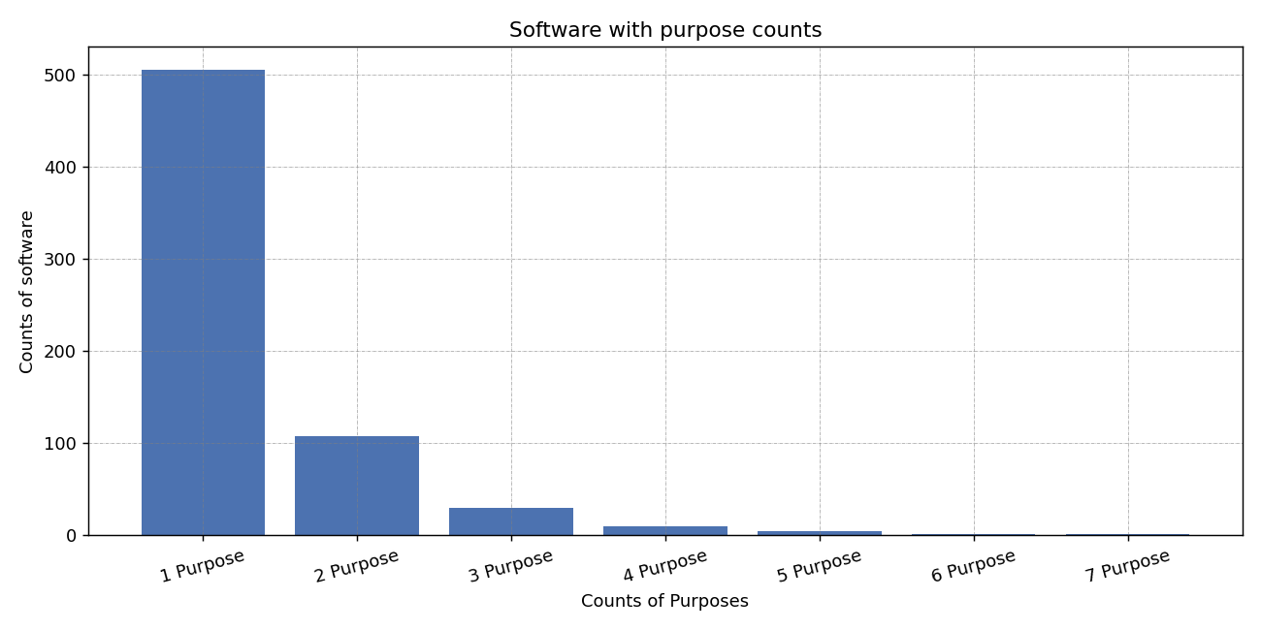
2. Annotate SoMeSci Dataset with software purpose.
2.4. Analysis of Annotated data

Slide 22
3. Classifier Model Selection
Software purpose classification approached as Sequence labeling task
Classical ML Models
DL Models
HMM
MEMM
CRF
RNN
LSTM
Bi-LSTM
Bi-LSTM-CRF
Transformer Based Model
BERT
Bio-BERT
Sci-BERT

Slide 23
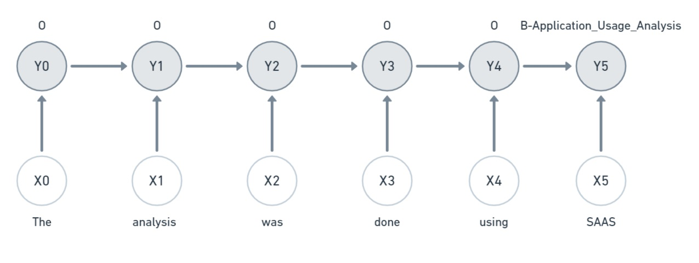
3. Classifier Model Selection
3.1. Classical (statistical) Models: HMM

Slide 24
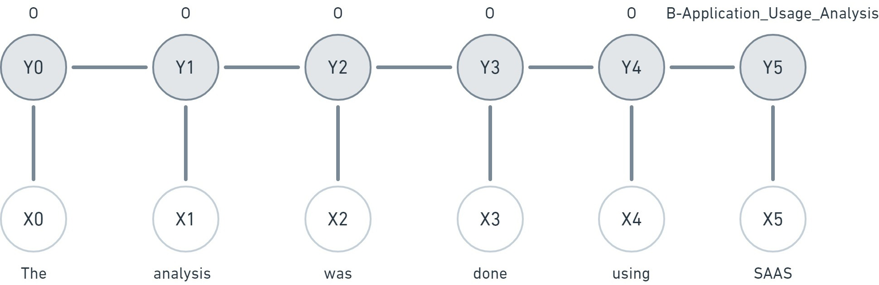
3. Classifier Model Selection
3.1. Classical (statistical) Models: CRF

Slide 25
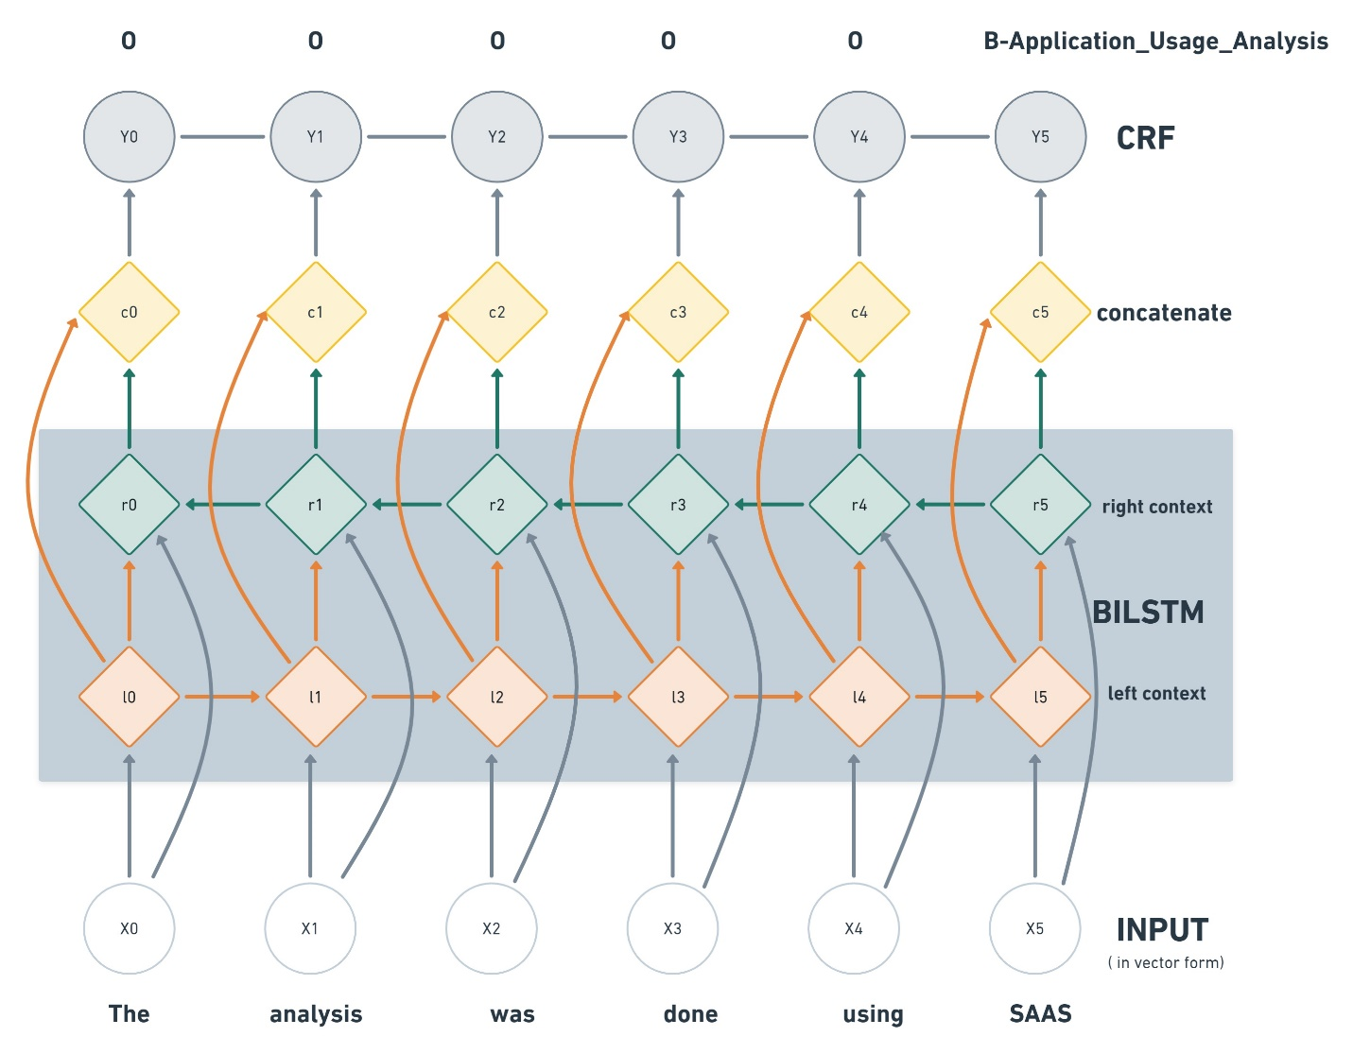
3. Classifier Model Selection
3.1. Deep Learning Models: Bi-LSTM-CRF

Slide 26
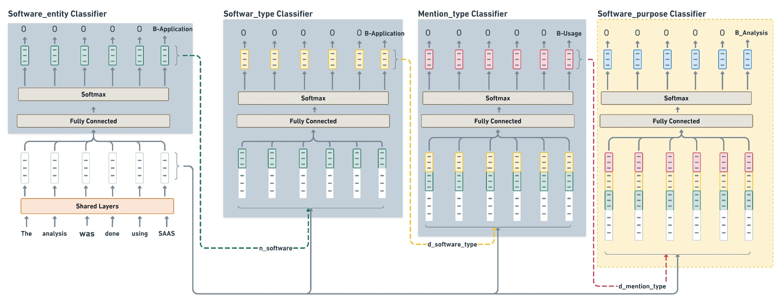
3. Classifier Model Selection
3.1. Deep Learning Models: BERT

Slide 27
4. Software purpose classification and evaluation
The impact of labeled data
The impact context
Left vs right context information
Context == whole paragraph
Context outside paragraph
Classification with 2-Cascade Sci-BERT
Bio-BERT vs Sci-BERT

Slide 28
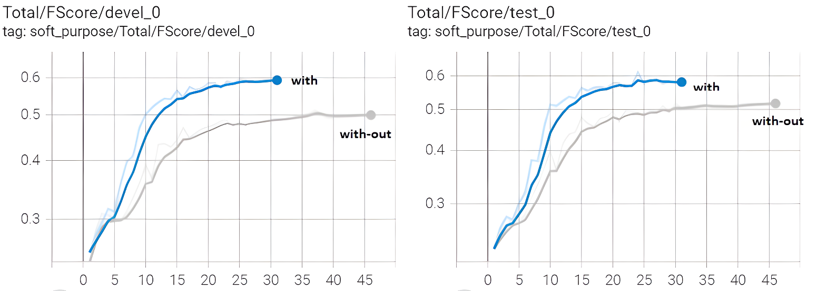
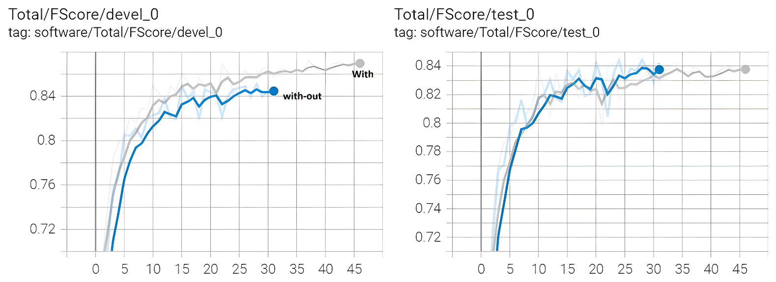
4. Software purpose classification and evaluation
4.1. The impact of labeled data

Slide 29
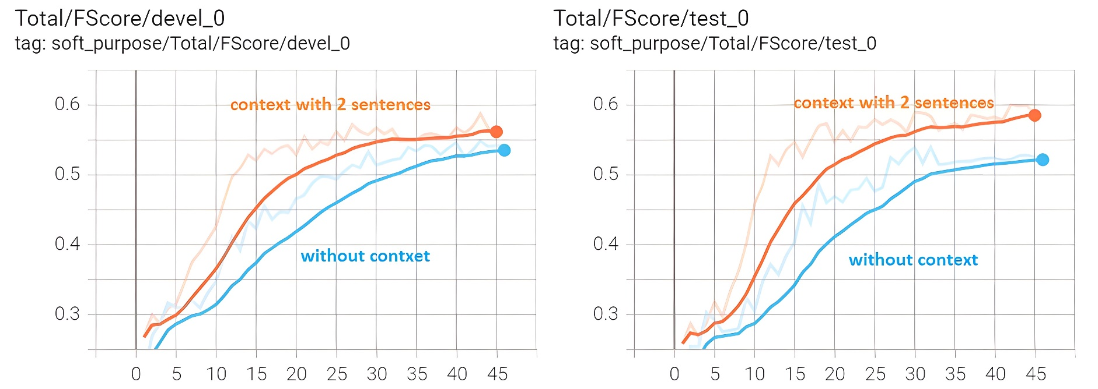
4. Software purpose classification and evaluation
4.2. The impact of larger context

Slide 30
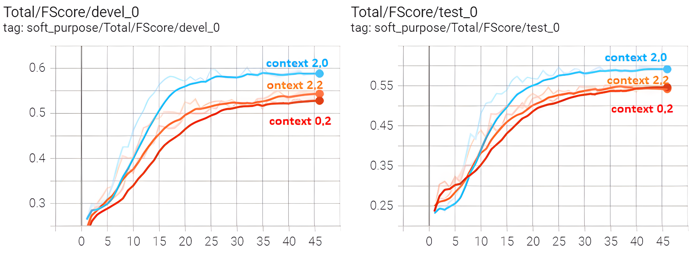
4. Software purpose classification and evaluation
4.3. Left-vs-Right Context

Slide 31
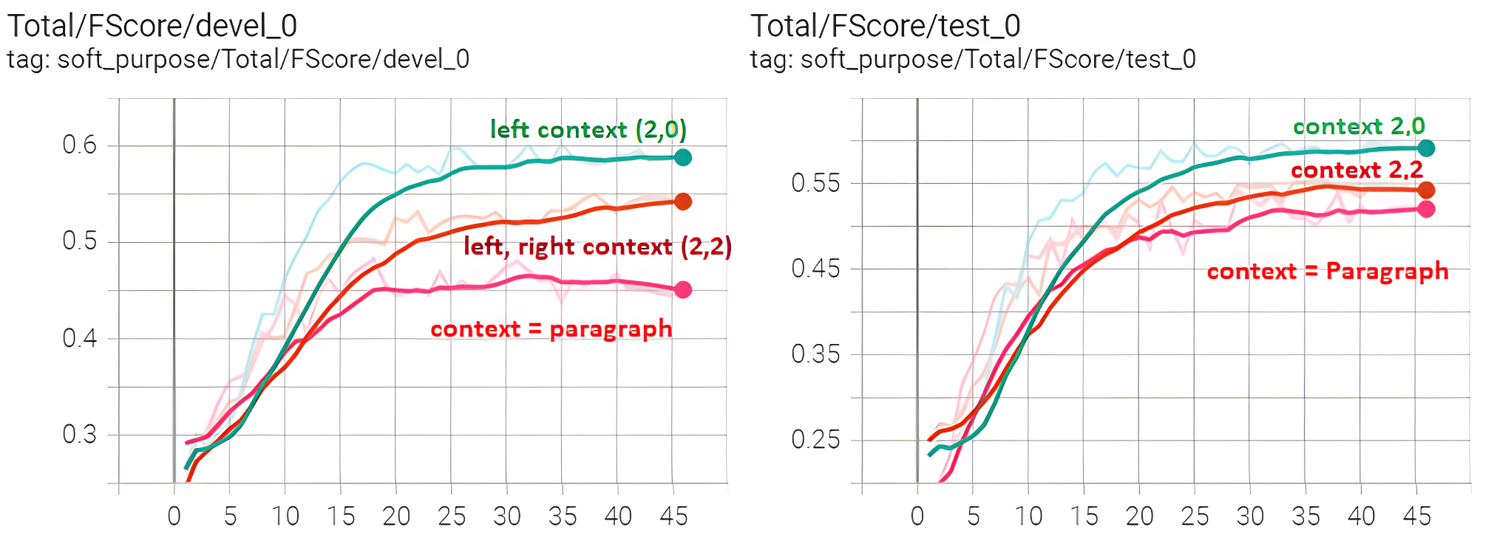
4. Software purpose classification and evaluation
4.4. Context == whole paragraph

Slide 32
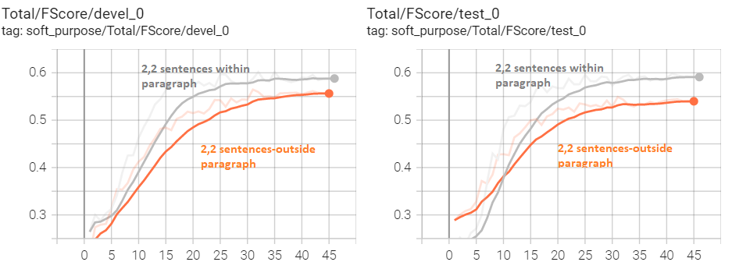
4. Software purpose classification and evaluation
4.4. Context == outside paragraph

Slide 33
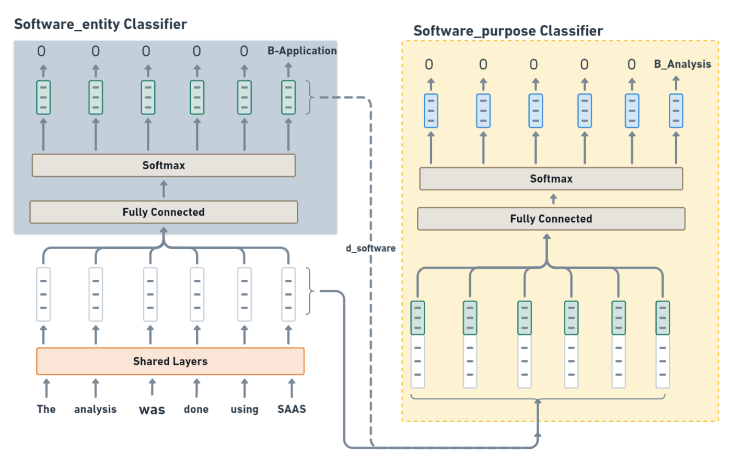
4. Software purpose classification and evaluation
4.5. Classification with 2-Cascade Sci-BERT

Slide 34
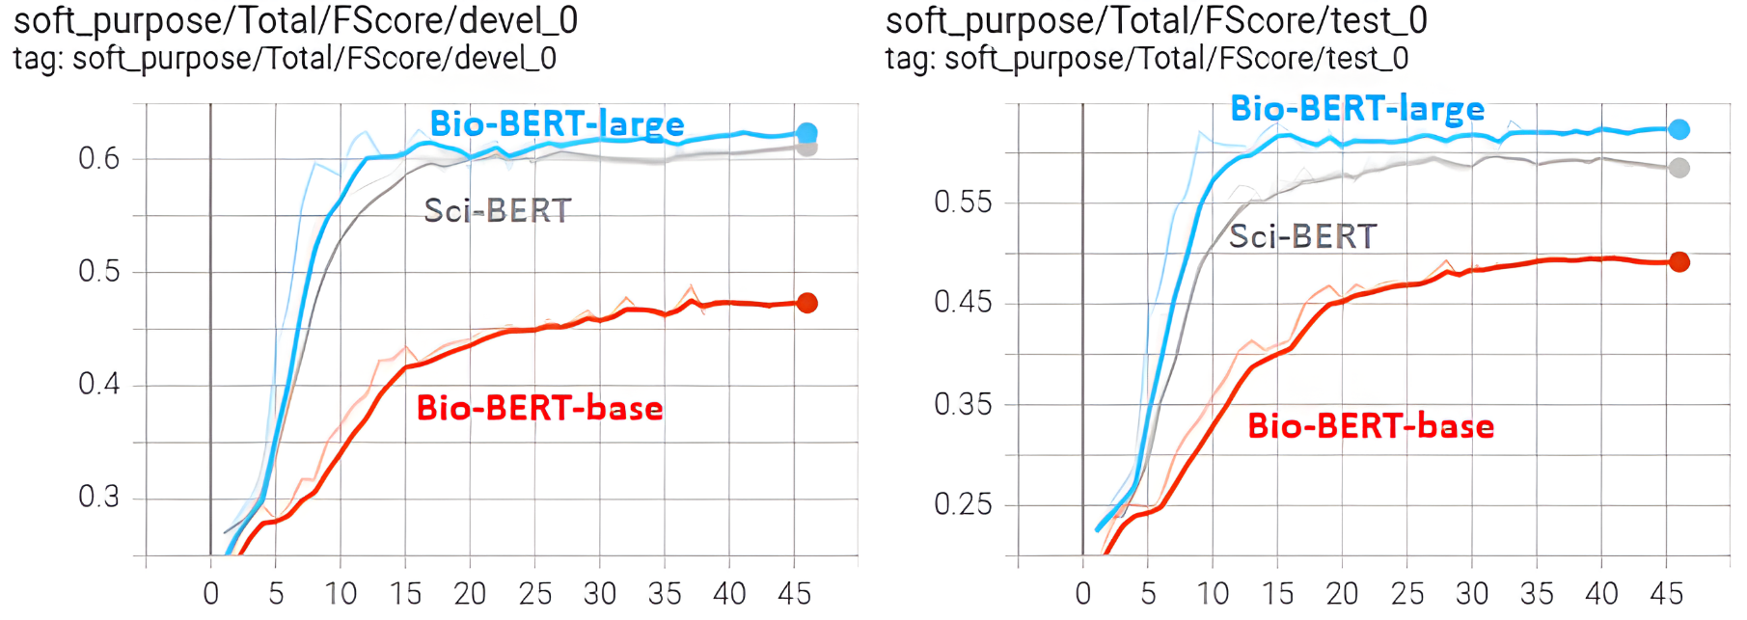
4. Software purpose classification and evaluation
4.5. Bio-BERT vs Sci-BERT

Slide 35
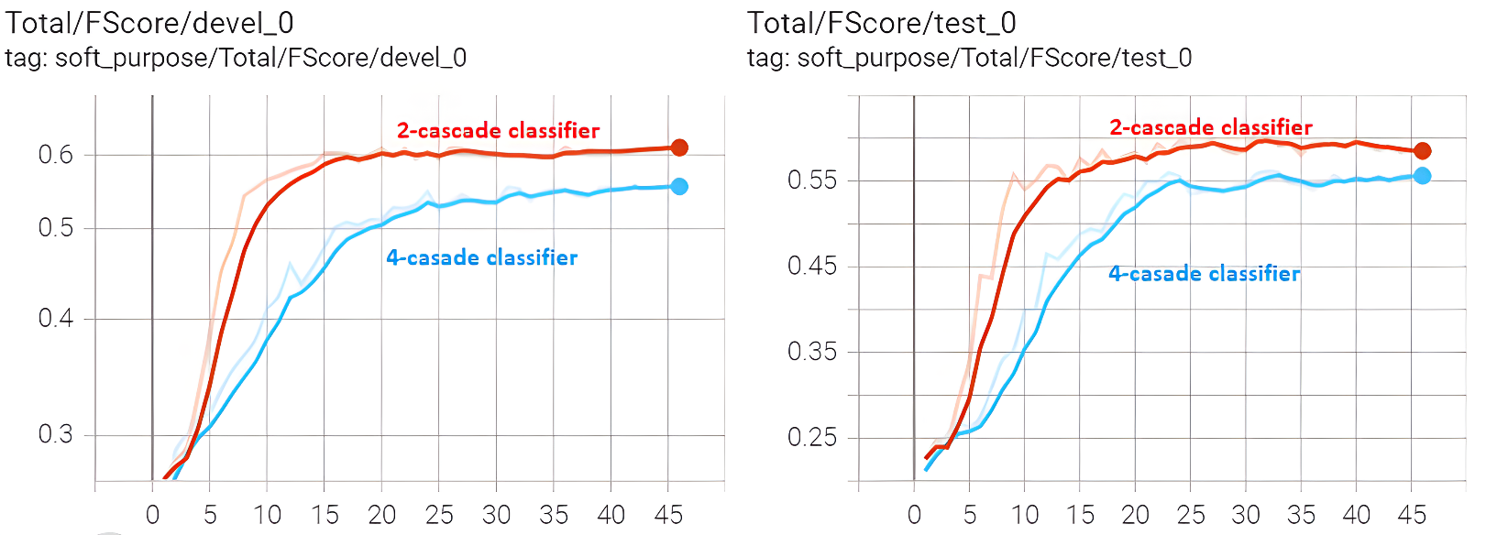
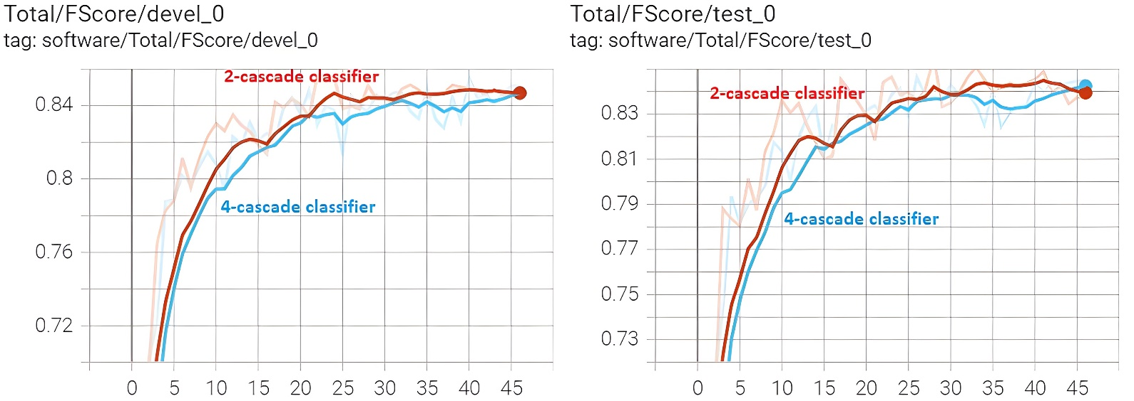
4. Software purpose classification and evaluation
4.5. Classification with 2-Cascade Sci-BERT

Slide 36
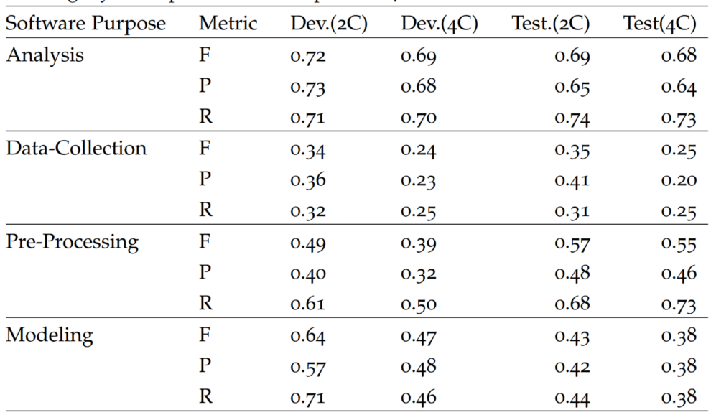
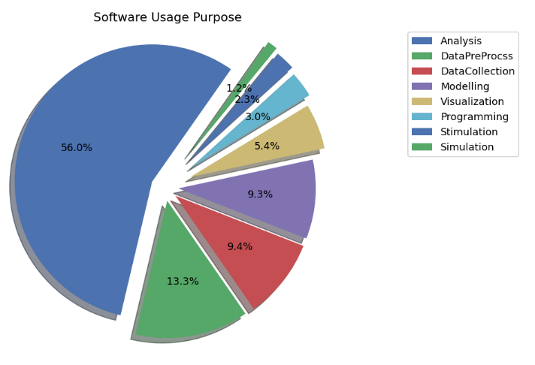
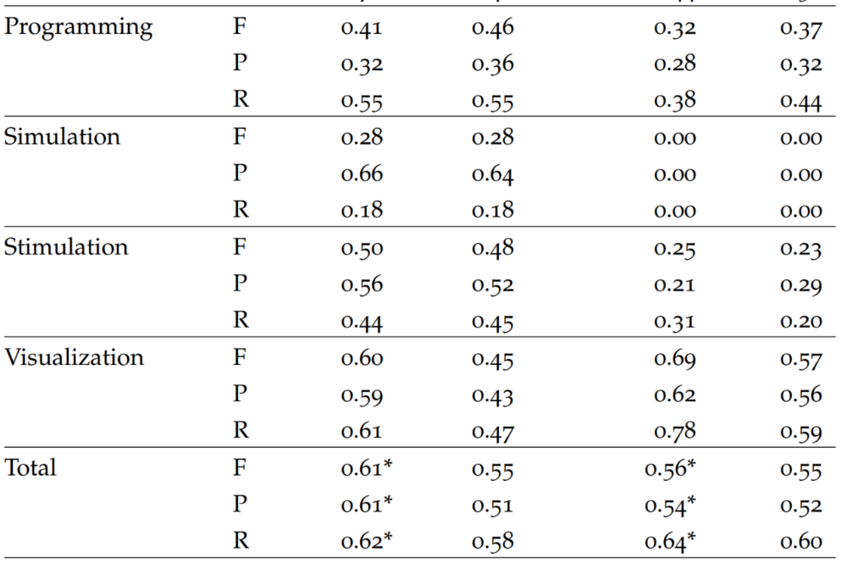
4. Software purpose classification and evaluation
4.5. Summary of classification performance 2C-Sci-BERT-Model

Slide 37
4. Summary and Conclusion
The role of software in scientific investigation is paramount.
Automatic classification of software usage purposes has been successful with a minimal set of annotated data set.
Various level of context affects classification performance. Two sentences from the left gives slightly better classification performance.
Unbounded context such as context as a whole paragraph or context outside a paragraph did not improve classification performance.
Classification with other variants of BERT model such as Bio-BERT-large gives a slightly better performance compared to Sci-BERT model, however it is slower.
Software purpose classification performance is greater for software purposes with larger number of class labels.

Slide 38
4. Future work
To increase classification performance, the remaining part of SoMeSci dataset can be annotated further and SoMeSci corpus size could also be increased.
Annotation of software usage purposes can also be done by domain experts.
Software tools that have similar purpose can be identified to cross-validate and compare results from various software tools.
Semantic browsing of scientific-articles can also be implemented based on a use of similar software for similar purpose.

Slide 39
Discussion ☺

